Slide 1
STRUCTURED PROGRAMMING

Slide 2
Structured Programming
Programming style to improve the quality, clarity and development time by make use of block structures.
Better way to program as it involves systematic organization of programs.
Structured Programming started in 70s,primarly against control constructs like gotos
The goal was to simplify the programming structure
Is now well established and followed.

Slide 3

Structured Programming…..
Main()
{
………….
……………
goto;
…………….
…………..
goto;
…………….
}

Slide 4
Structured programming
Structured programming is concerned with the structures used in computer program.
Generally structures of computer program comprise decisions, sequences and loops
Sequence
implements processing steps that are essential in the specification of any algorithm.
Condition (decision)
selected processing based on some logical occurrence
Repetition(loops)
allows for looping

Slide 5
Structured programming….
In structured programming, we sub-divide the whole program into small modules so that the program becomes easy to understand.
Linearize control flow through a computer program so that the execution sequence follows the sequence in which the code is written.
This linear flow of control can be managed by restricting the set of allowed applications construct to a single entry, single exit formats.

Slide 6
Structured programming…..
Primarily structured programming focus on reducing the following statements from our program
GOTO statements
Break or continue
Multiple exit points to a function ,procedure or subroutine.(ex. Multiple return statements)
Multiple entry points to a function ,procedure or subroutine
The key point of structured programming : single entry and single exit points.

Slide 7
Why we use Structured Programming?
The use of the structured constructs reduces program complexity
Enhances readability, testability, and maintainability.
The intent of structured programming is to assist the designer in defining algorithms that are less complex and therefore easier to read, test, and maintain.
If a program consists of thousands of instructions and an error occurs then it is complicated to find that error in the whole program.
but in structured programming, we can easily detect the error and then go to that location and correct it.
This saves a lot of time.

Slide 8
Rules in structured programming:
Structured Rule One: Code Block
If the entry conditions are correct, but the exit conditions are wrong, the error must be in the block.
#This is not true if the execution is allowed to jump into a block. The error might be anywhere in the program. Debugging under these circumstances is much harder.
In flow-charting condition, a box with a single entry point and single exit point are structured.
Structured programming is a method of making it evident that the program is correct.

Slide 9
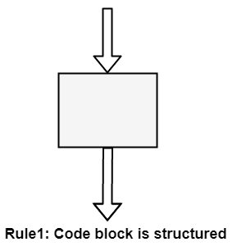
Rules in structured programming....

Slide 10
Rules in structured programming....
Structure Rule Two: Sequence
A sequence of blocks is correct if the exit conditions of each block match the entry conditions of the following block.
Execution enters each block at the block's entry point and leaves through the block's exit point.
The whole series can be regarded as a single block, with an entry point and an exit point.

Slide 11
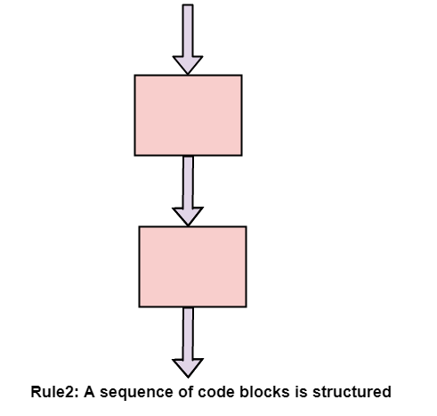
Rules in structured programming.....

Slide 12
Rules in structured programming....
Structured Rule Three: Alternation
If-then-else is frequently called alternation (because there are alternative options).
In structured programming, each choice is a code block.
If alternation is organized as in the flowchart at right, then there is one entry point (at the top) and one exit point (at the bottom).
The structure should be coded so that if the entry conditions are fulfilled, then the exit conditions are satisfied (just like a code block).

Slide 13
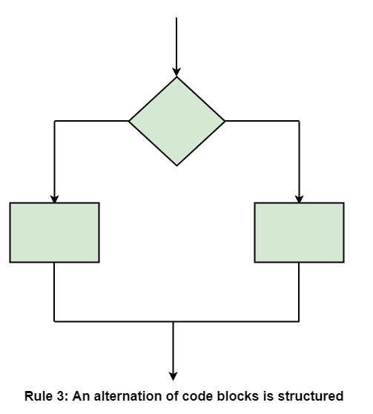
Rules in structured programming....

Slide 14
Rules in structured programming.....
Structured Rule 4: Iteration
Iteration (while-loop) is organized as at right.
It also has one entry point and one exit point.
The entry point has conditions that must be satisfied, and the exit point has requirements that will be fulfilled.
There are no jumps into the form from external points of the code.

Slide 15
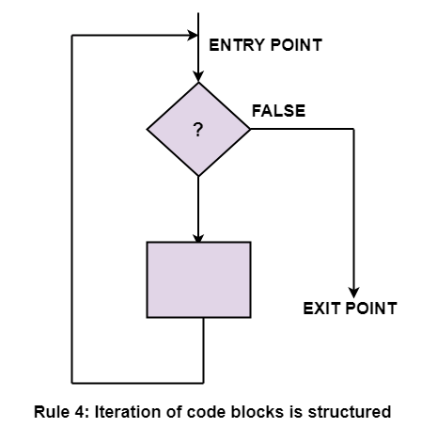
Rules in structured programming....

Slide 16
Structured Programming
Structured programming involves 3 phases
Top down analysis
Modular programming
Structured code

Slide 17
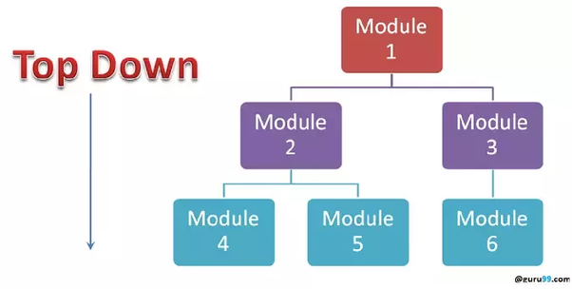
Top down analysis
Top down analysis is a problem solving mechanism whereby a given problem is successively broken down into smaller and smaller sub-problems or operations until a set of easily solvable (by computer) sub-problems is arrived at.

Slide 18
Modular programming
Software design technique that emphasizes separating the functionality of a program into independent, interchangeable modules, such that each contains everything necessary to execute only one aspect of the desired functionality
Modular programming will be helpful for large programs which are difficult to debug.
Leads to reuse the code which can be used in other programs
Debugging and finding errors is easy

Slide 19
Modular programming
Main()
{
…………..
…………
}
Module 1
{ independent
…………
}
Module 2 independent
{
……………
}
main()
{
……………..
……………
}

Slide 20
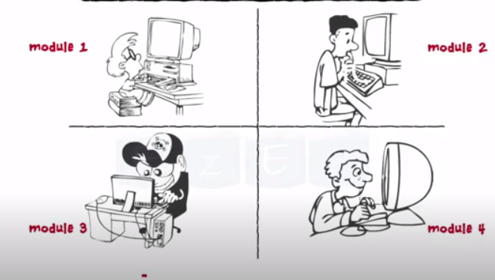
Advantage of modular programming

Slide 21
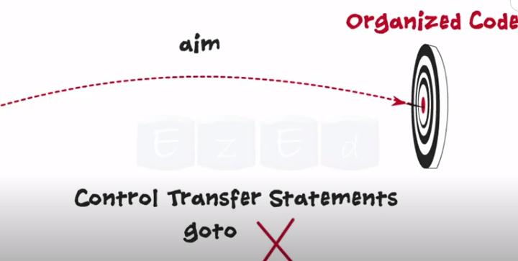
Structured Code
use of the structured control flow constructs of selection (if/then/else) and remove goto

Slide 22
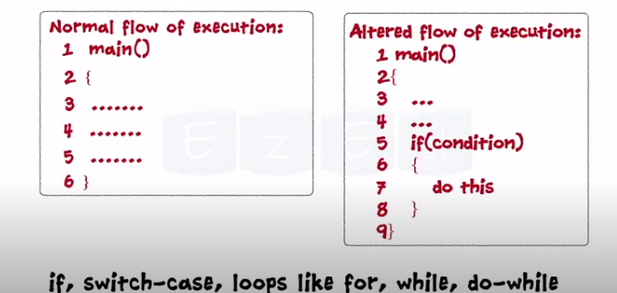
Structured code

Slide 23

CODING STANDARDS

Slide 24
CODING STANDARDS
Standardization has a positive impact on any business.
There are certain coding standards that are needed for successful software development.
A coding standard makes sure that all the developers working on the project are following certain specified guidelines.
The code can be easily understood and proper consistency is maintained.

Slide 25
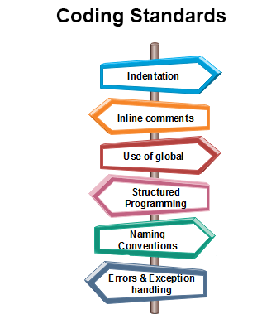
Coding Standards….
General coding standards refers to how the developer writes code, so here we will discuss some essential standards regardless of the programming language being used.

Slide 26
CODING STANDARDS……
Indentation:
Proper and consistent indentation is essential in producing easy to read and maintainable programs. Indentation should be used to:
Emphasize the body of a control structure such as a loop or a select statement.
Emphasize the body of a conditional statement
Emphasize a new scope block
Inline comments:
Inline comments analyze the functioning of the subroutine, or key aspects of the algorithm shall be frequently used.
Rules for limiting the use of global:
These rules file what types of data can be declared global and what cannot.

Slide 27
CODING STANDARDS……
Structured Programming:
Structured (or Modular) Programming methods shall be used.
"GOTO" statements shall not be used as they lead to "spaghetti" code, which is hard to read and maintain.
Naming conventions for global variables, local variables, and constant identifiers:
A possible naming convention can be that global variable names always begin with a capital letter,
local variable names are made of small letters, and constant names are always capital letters.
Error return conventions and exception handling system:
Different functions in a program report the way error conditions are handled should be standard within an organization.
Error handling is an essential aspect of computer programming. This does not only include adding the necessary logic to test for and handle errors but also involves making error messages meaningful.

Slide 28
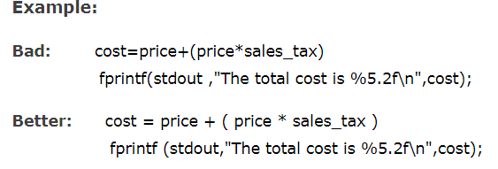
CODING STANDARDS……
Line Length:
It is considered a good practice to keep the length of source code lines at or below 80 characters. Lines longer than this may not be visible properly on some terminals and tools. Some printers will truncate lines longer than 80 columns.
Spacing:
The appropriate use of spaces within a line of code can improve readability.

